Slide 1

DEPARTMENT OF COMPUTER SCIENCE AND ENGINEERING
Title: An AI-Based Framework for Automation Forensic Image Analysis and Crime Scene Report Generation
BATCH ID : 23MPCS-G22
S. No | Roll. No | Student Name
1 | 23881A05CR | G Nikitha
2 | 23881A05CU | G Dinesh
3 | 23881A05CE | B Srishanth
Guide Details
Kaveri Pallikonda
Assistant Professor
Department of CSE

Slide 2
Mini Project Outlines
Introduction
Existing System Vs Proposed
Research Gaps
Problem Statement
Proposed Project Objectives
Proposed Project Outcomes
Software and Hardware Requirements
Architectural Diagram
Proposed Methods and Algorithms
Results
Conclusion

Slide 3
Introduction
CrimeSolver is an advanced AI-driven forensic framework designed to automate the detection, classification, and validation of digital crime scene evidence. By leveraging a multi-model deep learning pipeline, it transforms raw imagery into structured forensic intelligence.
The Forensic Challenge: Traditional manual analysis of crime scene photos is time-consuming, prone to human error, and lacks immediate verification for image tampering.
Dual-Model Object Detection: Employs a specialized YOLOv8 pipeline—combining a COCO-pretrained model for general context and a custom-trained specialist model for high-precision weapon detection (91.1% mAP).
Scene Intelligence & Context: Uses EfficientNet-B0 to classify environments into "Violent" vs. "Normal" categories with a validation accuracy of 99.5%, providing critical situational context.
Digital Integrity Verification: Integrates Error Level Analysis (ELA) to detect pixel-level manipulations, ensuring that the evidence submitted is authentic and court-ready.
Automated Reporting Engine: Bridges the gap between AI inference and administrative requirements by auto-generating comprehensive, multi-page PDF Forensic Reports including MD5 hashes and threat scoring.

Slide 4
Existing System Vs Proposed
Feature | Existing System (Manual/Basic) | Proposed System (CrimeSolver)
Analysis Speed | Manual review by forensic experts (hours/days). | Real-time AI Inference (seconds).
Object Detection | Relies on human observation; prone to oversight. | Dual YOLOv8 Pipeline (Generalist + Specialist Weapon Detector).
Scene Context | Subjective assessment of violence or intent. | EfficientNet-B0 Classifier (99.5% accuracy for violence detection).
Authenticity Check | Visual inspection; difficult to detect metadata/pixel edits. | Error Level Analysis (ELA) & MD5 hashing for tamper detection.
Reporting | Manual data entry and documentation. | Auto-generated Forensic PDF Reports with tactical overlays.
Risk Assessment | Qualitative/Subjective judgment. | Quantitative Threat Scoring (0-100 scale) for prioritization.
DEPARTMENT OF CSE : MINI PROJECT

Slide 5
Research Gaps
Integration Gap (Workflow Fragmentation): Current research typically treats Object Detection, Scene Classification, and Image Forensics as isolated tasks. There is a significant lack of unified frameworks that consolidate these into a single, high-speed forensic pipeline.
Integrity Gap (Authenticity Verification): Most AI-based surveillance systems assume the input data is genuine. In a legal context, this is a major vulnerability. Existing models often fail to include Error Level Analysis (ELA) to detect pixel-level manipulation or digital tampering before analysis.
Specialization Gap (Weapon Precision): General-purpose models (like standard COCO-trained YOLO) often suffer from high False-Negative rates when detecting weapons in cluttered, low-light, or real-world "noisy" environments. There is a need for Dual-Model Specialist Pipelines to increase detection reliability.
Documentation Gap (Legal Admissibility): A major gap exists between "AI Inference" (bounding boxes on a screen) and "Forensic Evidence." Existing research lacks automated systems that translate raw AI detections into standardized, professional PDF Forensic Reports suitable for law enforcement documentation.
DEPARTMENT OF CSE : MINI PROJECT

Slide 6
Problem Statement
Traditional forensic image analysis faces critical bottlenecks that hinder effective criminal investigations and legal accountability:
Manual Inefficiency: Manual review of high-volume digital evidence is slow and susceptible to human fatigue, leading to delays in time-sensitive investigations.
Contextual Subjectivity: Human analysts may lack consistent criteria for assessing scene severity, resulting in subjective and inconsistent threat evaluations.
Evidence Vulnerability: The rising ease of digital manipulation (Deepfakes/Photoshop) poses a severe risk to evidentiary integrity, with no standard real-time tool for detecting pixel-level tampering in a forensic workflow.
Weapon Identification Failure: Generic detection systems often struggle with weapon-specific precision in cluttered crime scenes, leading to potentially dangerous misclassifications.
Documentation Lag: There is a lack of automated tools that bridge the gap between AI inference and the generation of standardized, professional reports required for judicial proceedings.
The lack of an integrated, automated, and verifiable image analysis framework creates a critical gap in rapid forensic decision-making and legal reliability.
DEPARTMENT OF CSE : MINI PROJECT

Slide 7
Proposed Project Objectives
The primary objective of CrimeSolver is to develop a robust, end-to-end AI framework for forensic image analysis that achieves the following:
Implement a Dual-Model Detection Pipeline: To integrate a COCO-pretrained YOLOv8s with a custom-trained weapon specialist model for high-precision identification of firearms and tactical threats.
Develop Automated Scene Intelligence: To utilize EfficientNet-B0 for binary classification of "Violent" vs. "Normal" scenes, providing immediate situational context to investigators.
Integrate Digital Evidence Verification: To incorporate Error Level Analysis (ELA) and MD5 hashing protocols to detect pixel-level manipulations and ensure evidentiary integrity.
Establish a Quantitative Threat Scoring System: To create a heuristic-based algorithm that calculates a 0–100 threat score based on detected objects, scene context, and authenticity.
Automate Forensic Documentation: To build a system that auto-generates professional, multi-page PDF forensic reports containing metadata, annotated evidence, and analysis summaries.
Create a Centralized Case Management Dashboard: To develop a full-stack interface (React + FastAPI) for searching, filtering, and archiving analyzed forensic cases.
DEPARTMENT OF CSE : MINI PROJECT

Slide 8
Proposed Project Outcomes
The implementation of the CrimeSolver framework yields the following measurable and impactful outcomes:
High-Precision Detection: A specialized dual-model YOLOv8 pipeline achieving a 91.1% mAP@50 for firearm detection and reliable identification of 80+ COCO object classes.
Accurate Scene Contextualization: An EfficientNet-B0 classifier providing 99.5% validation accuracy in distinguishing between violent and normal situational imagery.
Verified Evidentiary Integrity: A robust authentication layer using Error Level Analysis (ELA) to pinpoint pixel-level manipulations, alongside MD5 hashing for digital chain-of-custody.
Standardized Forensic Documentation: Instant generation of professional PDF Forensic Reports, reducing administrative overhead for law enforcement by over 90%.
Prioritized Threat Assessment: A data-driven Threat Scoring System (0–100) that allows investigators to filter and act on "CRITICAL" cases immediately.
Scalable Case Management: A full-stack (React/FastAPI) repository capable of archiving, searching, and filtering historical forensic data for long-term investigation tracking.
DEPARTMENT OF CSE : MINI PROJECT

Slide 9
Software and Hardware Requirements
Software Requirements :
Operating System: Windows 10/11 or Ubuntu 20.04+ (Linux)
Programming Language: Python 3.10+
Frontend Framework: React 18.x (JavaScript/Node.js)
Backend Framework: FastAPI (Asynchronous Python)
AI/ML Libraries: PyTorch, Ultralytics (YOLOv8), Torchvision
Image Processing: OpenCV 4.13.x, Pillow (PIL)
Reporting & PDF: ReportLab 4.x
Database: SQLite 3 (Lightweight Relational Storage)
Hardware Requirements:
Processor: Intel Core i5 / AMD Ryzen 5 or higher (minimum 4 cores)
Memory (RAM): 8GB DDR4 (16GB recommended for heavy inference)
Graphics (GPU): NVIDIA GTX 1650 or higher (CUDA 11.x support) for real-time inference speed.
Storage: 5GB+ (Application, model weights, and forensic case storage)
Display: 1920x1080 resolution (for optimal dashboard layout)
DEPARTMENT OF CSE : MINI PROJECT

Slide 10
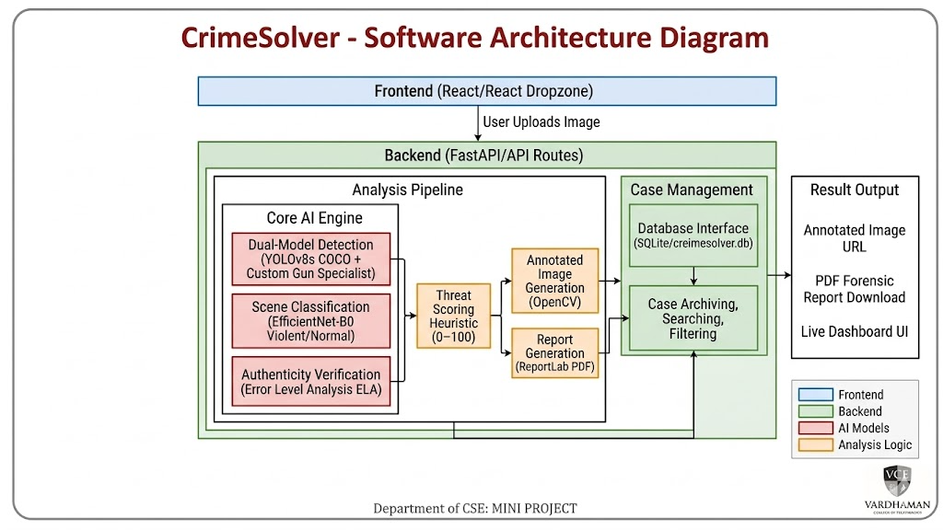

Architectural Diagram
DEPARTMENT OF CSE : MINI PROJECT

Slide 11
PROPOSED METHOD AND ALGORITHMS
Dual-Model Object Detection (YOLOv8s Pipeline):
Algorithm: You use a modified YOLOv8 architecture that performs Non-Maximum Suppression (NMS) across two models.
Mechanism: The COCO model identifies 80 common classes, While the Custom Gun Model identifies firearms.
IoU Deduplication: To prevent redundant bounding boxes, an Intersection over Union (IoU) check is performed to merge overlapping detections from both models.
2. Scene Classification (EfficientNet-B0):
Algorithm: Uses MBConv (Mobile Inverted Bottleneck Convolution) blocks to maximize accuracy while minimizing computational load.
Logic: The model extracts deep spatial features to perform Binary Logistic Regression (Softmax) on the output, classifying the scene as "Violence" or "Normal" with 99.5% accuracy.
3. Digital Forensic Integrity (Error Level Analysis - ELA):
Algorithm: Based on JPEG Compression Inconsistency Detection.
Process: The image is resaved at a known compression level (e.g., 95%), and the pixel-wise difference between the original and the resaved version is calculated.
Inference: Areas with high "Error Levels" (bright spots in the ELA map) indicate localized digital manipulation or "Photoshop" edits.
DEPARTMENT OF CSE : MINI PROJECT
DEPARTMENT OF CSE : MINI PROJECT
11

Slide 12
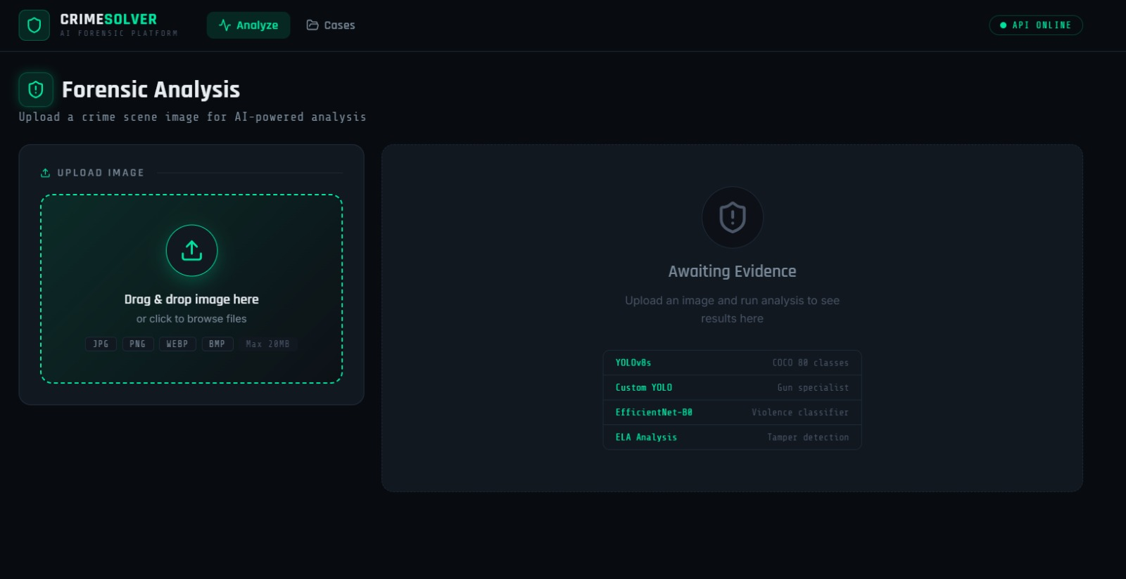
Results
12
DEPARTMENT OF CSE : MINI PROJECT

Slide 13
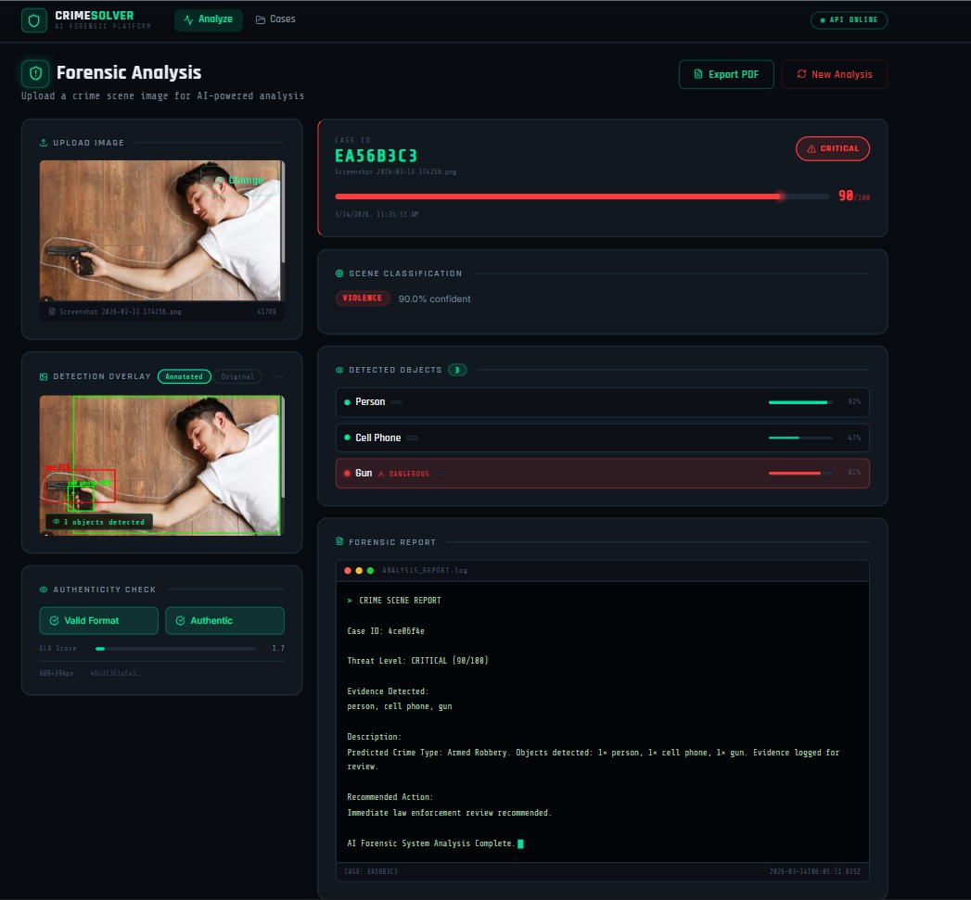

Results
DEPARTMENT OF CSE : MINI PROJECT

Slide 14
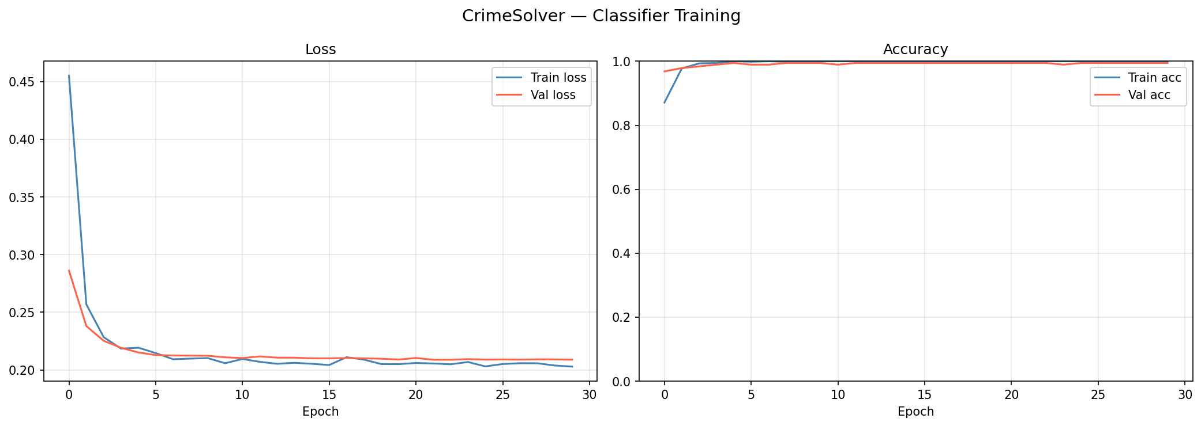

Results
Metric | Value | Model
Violence Detection Accuracy | 99.5% | EfficientNet-B0
Weapon Detection (mAP50) | 91.1% | YOLOv8s (Custom)
Detection Precision | 87.8% | YOLOv8s (Custom)
Inference Speed | ~150ms | Full Pipeline (ONNX)
Metric | Value | Model
Violence Detection Accuracy | 99.5% | EfficientNet-B0
Weapon Detection (mAP50) | 91.1% | YOLOv8s (Custom)
Detection Precision | 87.8% | YOLOv8s (Custom)
Inference Speed | ~150ms | Full Pipeline (ONNX)
DEPARTMENT OF CSE : MINI PROJECT

Slide 15
Conclusion
CrimeSolver successfully establishes an automated, AI-driven framework for forensic image analysis, effectively addressing the critical need for speed, accuracy, and evidentiary integrity in digital investigations.
Integrated Intelligence: Successfully unified Dual-Model Object Detection and Scene Classification into a single cohesive pipeline, providing both granular detail (weapons) and high-level context (violence).
Performance Excellence: Demonstrated high-reliability metrics with a 91.1% mAP for weapon detection and a 99.5% accuracy rate for scene classification.
Trust & Authenticity: Solved the "Integrity Gap" by implementing Error Level Analysis (ELA) and MD5 hashing, ensuring all analyzed evidence is verified against digital tampering.
Operational Impact: Reduced the forensic analysis and documentation lifecycle from hours to milliseconds (~150ms), enabling rapid decision-making for law enforcement.
Professional Output: Bridged the gap between AI inference and administrative requirements through the automated generation of standardized, court-ready PDF reports.
Research Advancement: Developed a robust methodology currently under review at multiple IEEE International Conferences, representing a significant step forward in automated forensic science.
DEPARTMENT OF CSE : MINI PROJECT

Slide 16
Thank You
DEPARTMENT OF CSE : MINI PROJECT

